Slide 1


Slide 2
Business Analytics – The Science of Data Driven Decision Making
Chapter 1 - Introduction
U Dinesh Kumar
© U Dinesh Kumar, IIM Bangalore

Slide 3
In God we trust, all others must bring data
- W Edwards Deming
U Dinesh Kumar, IIM Bangalore

Slide 4
Business Analytics - Definition
Business analytics (BA) refers to the tools, techniques and processes for continuous exploration and investigation of past data to gain insights and help in decision making and problem solving.
Business Analytics is an integration between business/problem context, technology and data science that assist data driven decision making/problem solving.

Slide 5
Extracting value from the data
Statistical models & Machine Learning Algorithms
Data Science
Problems, Opportunities,
Decision Scenarios
Data collection, storage,
retrieval Software tools
Business Context
Technology

Slide 6
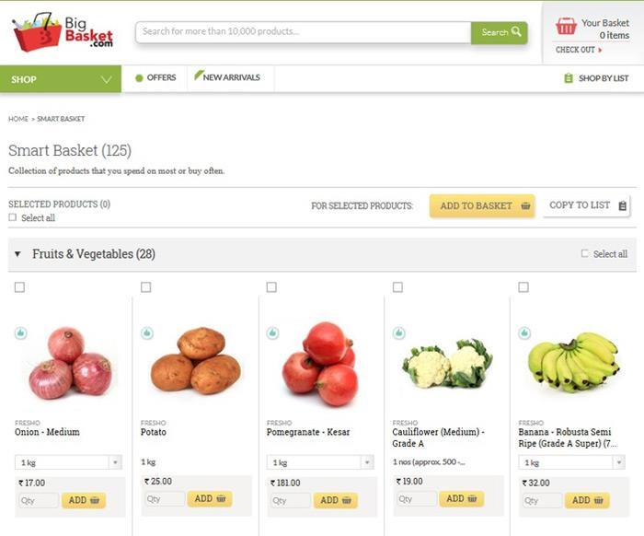
Analytics in E-Commerce (Big Basket)
U Dinesh Kumar, IIM Bangalore

Slide 7
Why Analytics?
U Dinesh Kumar, IIM Bangalore

Slide 8
ANALYTICS
Competitive
Strategy
Data is everything
Decision Making
(What promotion Strategy to use)
Problem Solver (Optimal Product Mix)
Process Improvement
(Reduce procurement cycle time)
U Dinesh Kumar, IIM Bangalore

Slide 9
Analytics for Process Improvement
🞂​ Banking – Cheque clearance time
🞂​ Healthcare – Patient discharge time
🞂​ Manufacturing – Waste minimization
🞂​ Retail – Waiting time at check out counters
🞂​ E-commerce – Time to deliver the customer order

Slide 10
Analytics for Problem Solving
🞂​ Banking – Reduce non-performing assets, Predict Fraud
🞂​ Healthcare – Improve net promoter’s score (NPS)
🞂​ Manufacturing – Reduce inventory management cost
🞂​ Retail – Assortment planning and shelf space allocation
🞂​ E-commerce – Predict customer cancellations and Fraud

Slide 11
Analytics for Decision Making
🞂​ Banking – Loan approval and the interest rate
🞂​ Healthcare – Introducing new specialties
🞂​ Manufacturing – Whether to introduce a new product
🞂​ Retail – Markdown Pricing
🞂​ E-commerce – Promotions

Slide 12
Analytics is necessary for survival
U Dinesh Kumar, IIM Bangalore

Slide 13
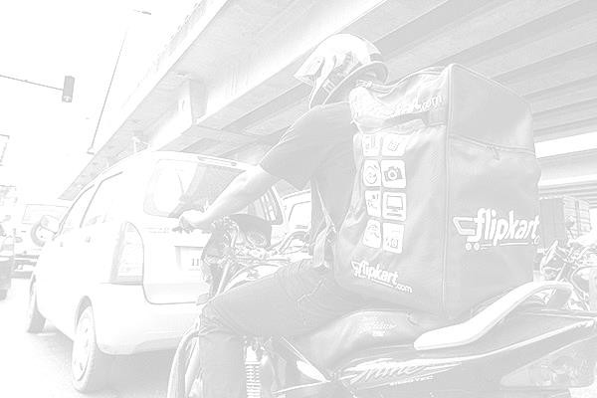
Problems faced by E-commerce companies such as Amazon and Flipkart
🞂​ Forecast demand for each SKU.
🞂​ Predict customer cancellations and returns.
🞂​ Predict customer contacts at the customer service.
🞂​Predict what a customer is likely to purchase in the future?
🞂​ How to optimize the delivery system?

Slide 14
The Game Changers…
🞂​ Google
🞂​ Used Markov chains to rank pages
🞂​ Proctor and Gamble
🞂​ Analytics as competitive strategy.
🞂​ Target
🞂​ Predicts customer pregnancy.
🞂​ Capital One
🞂​ Identifies the most profitable customer.
🞂​ Hewlett Packard
🞂​ Developed “flight risk score” for 3,30,000 employees.
🞂​ Obama’s 2012 presidential campaign.
🞂 Persuasion Modelling.

Slide 15
The Innovators…
🞂​ OKCupid: Predicts which online dating messages is most likely to
get a response!
🞂​ Polyphonic HMI: Uses “hit song science” to predict commercial
success of a song.
🞂​ Netflix: Predicts movie ratings by customers (RMSE is 1%).
🞂​ Amazon.com: 35% of sales come from product recommendations.
🞂​ Divorce360.com: Predicting success of a marriage!

Slide 16

Components of Analytics
Predicting future events
Data synthesis and
Visualization
Descriptive Analytics
Predictive Analytics
Prescriptive Analytics
Optimization and decision
making
U Dinesh Kumar, IIM Bangalore

Slide 17
Descriptive
Analytics
Predictive
Analytics
Prescriptive
Analytics
What Happened ?
What Will Happen ?
What Action to Take ?

Slide 18
Power of Descriptive Analytics
U Dinesh Kumar, IIM Bangalore

Slide 19
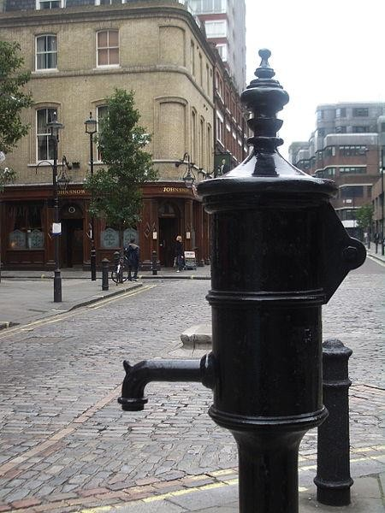
London Cholera Outbreak - 1854
Severe outbreak of cholera that occurred near Broad Street (now
Broadwick street) in Soho district of London in 1854.
More than 500 people died within 10 days of the outbreak, the
mortality rate in some parts of the city was as high as 12.8%.

Slide 20
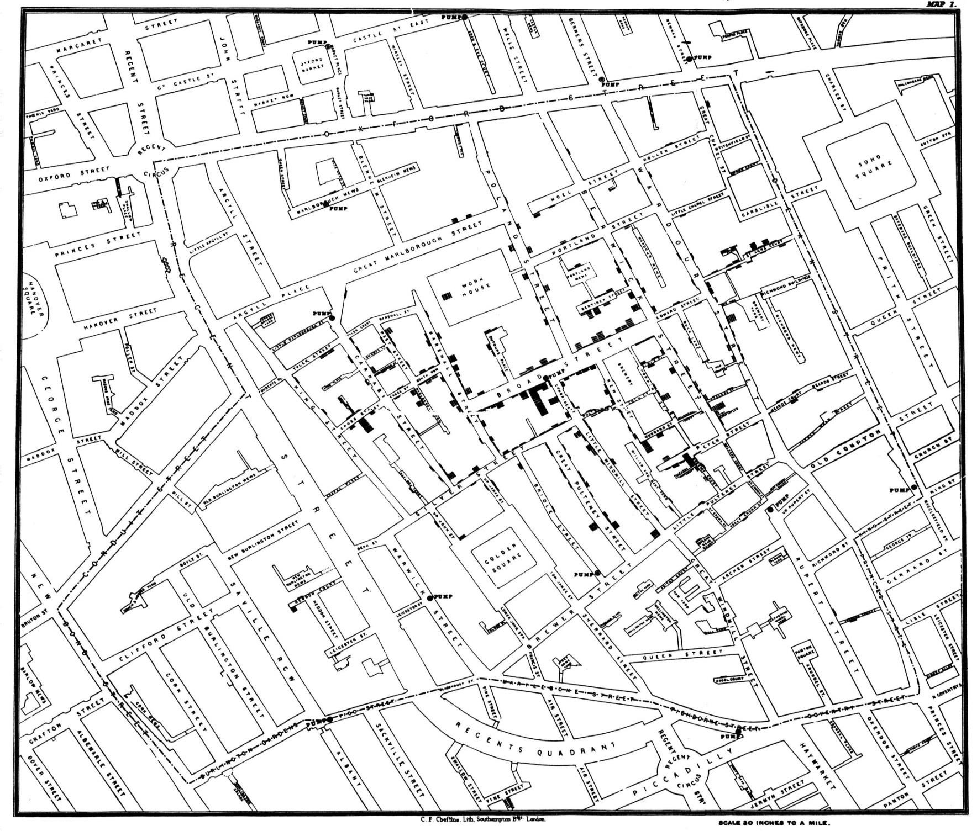

U Dinesh Kumar, IIM Bangalore

Slide 21
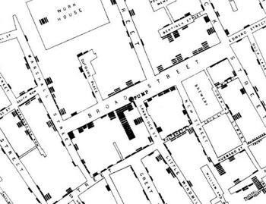
U Dinesh Kumar, IIM Bangalore

Slide 22
To understand statistics, for purpose.
God’s
these
study are the measures of his
thoughts, we must
- Florence Nightingale
U Dinesh Kumar, IIM Bangalore

Slide 23
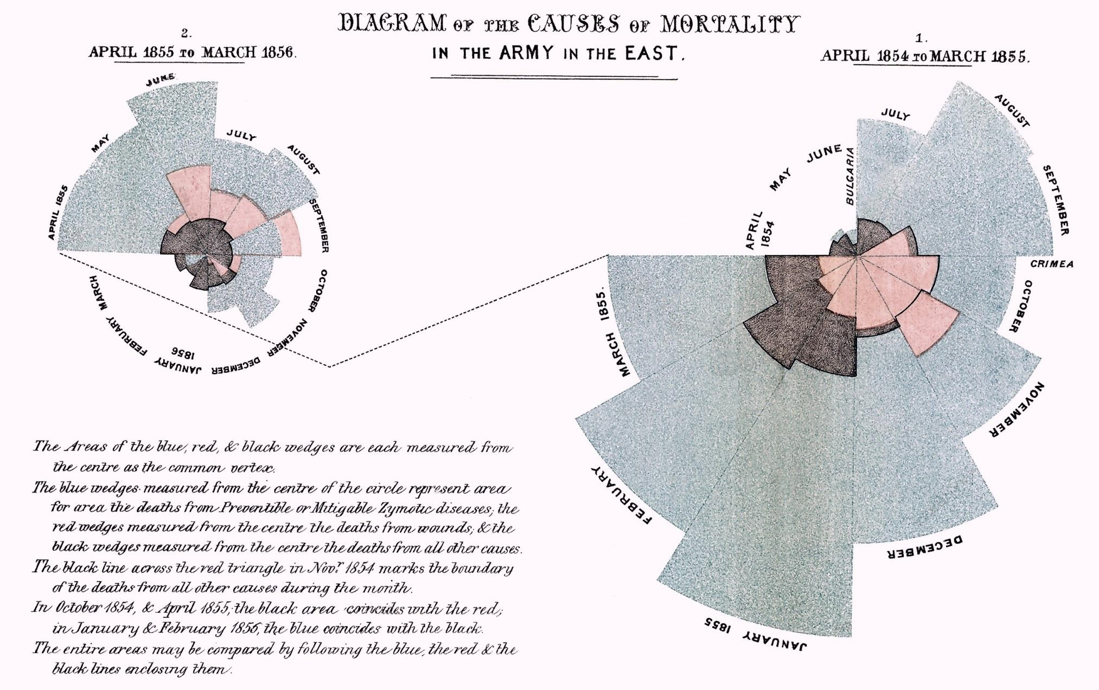
Crimean War Data (1853-1856)
Florence Nightingale’s Pie Chart
U Dinesh Kumar, IIM Bangalore

Slide 24

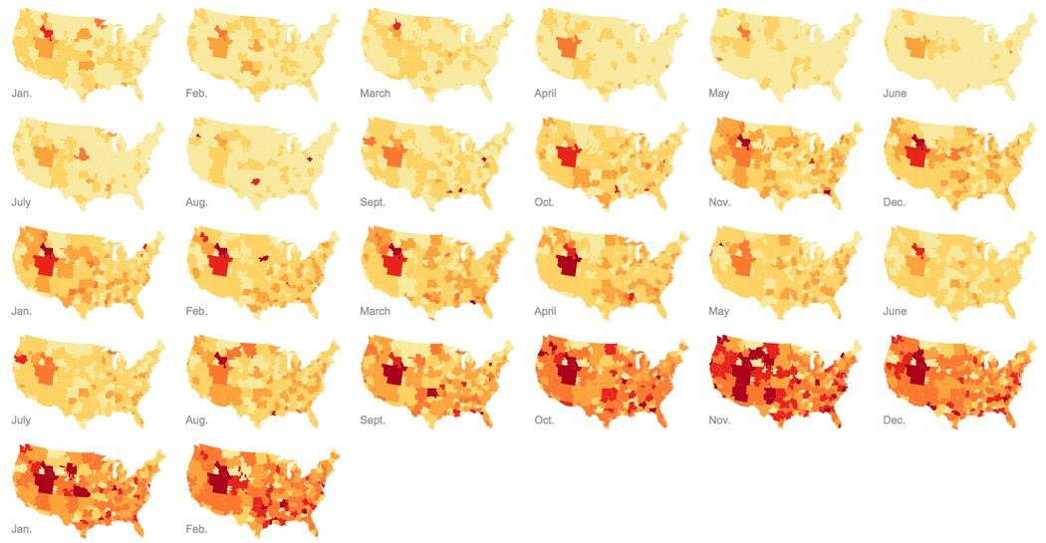
Google Fashion Trends
Link to Google Fashion Trends
http://www.nytimes.com/interactive/2015/0 4/27/business/google-fashion-trends- map.html
U Dinesh Kumar, IIM Bangalore

Slide 25
Descriptive Analytics Applications
🞂​ Most shoppers turn towards right when they enter the a retail
store.
🞂​ Conversion rate of women shoppers is higher than male
shoppers among electronic gadgets purchasers (Radio Shack).
🞂​ Strawberry pop-tarts sell 7 times more during hurricane
compared to regular period (Wal Mart).
🞂​ Women car buyers prefer women sales person.

Slide 26
Predictive Analytics Problems
🞂​Which product the customer is likely to buy in his next purchase (recommender system).
🞂​ Which customer is likely to default in his/her loan payment.
🞂​ Who is likely to cancel the product that was ordered through e-commerce portal.

Slide 27
Prescriptive Analytics Problem
🞂​ What is the optimal product mix?
🞂​ What is the optimal route for a delivery truck.
🞂​ Best markdown pricing for fashion products.
🞂​ Optimal assignment of aircraft to flight.
🞂​How to manage the fleet of vehicles owned by a company for employee drop and pick up?

Slide 28
Industry wide applications of analytics
Industry Sector | Sample Analytical problems | Data Sources
Manufacturing | Supply Chain Analytics Quality and process improvement Revenue and cost management Warranty Analytics | Procurement , sales and production data Warranty and after sales service Commodity Price Data Manufacturing Data Macroeconomic Data
Retail | Assortment Planning Promotion Planning Demand forecasting Market Basket Analysis Customer Segmentation | Price data Demand data at SKU and at category level SKU level sales data with and without promotions Planogram Customer demographics data Point of sales data Loyalty program data
Healthcare | Clinical care Hospitality related data | All patient care related data Hospitality related data Patient feedback data
U Dinesh Kumar, IIM Bangalore

Slide 29
Contd..
Industry Sector | Sample Analytical problems | Data Sources
Service | Demand forecasting NPS Optimization Service Quality Analysis Customer Segmentation Promotion | Transactional and feedback data Pricing and demand data Promotional data
Banking & Finance | Assortment Planning Promotion Planning Demand forecasting Market Basket Analysis Customer Segmentation | Customer transactional data Loan originating data Credit scoring data
IT and ITES(IT enabling Services) | Demand for Analytics Services Software Development Cycle time | Customer interaction and market research data Internal product development data
**Primary sources of data and secondary sources to be used in solving these analytical problems
U Dinesh Kumar, IIM Bangalore

Slide 30
Big Data
🞂​ Big data refers to high volume of data generated at high velocity that contains large variety of data.
🞂​According to Gartner Report, data is classified as big data, when:
🞂​ Volume: Exabytes
🞂​ Velocity: Sub-second
🞂​ Variety: 25+ formats
🞂​ Veracity: Accuracy of the data

Slide 31
Sources of Big Data
🞂​ Transactional data that are generated at high speed (mobile services, banking and financial services, healthcare, entertainment etc).
🞂​ Machine generated data (electricity and water meters, sensors installed in various systems).
🞂​ Social media data.
🞂​ Machine generated unstructured data (videos, satellite images etc).

Slide 32
4 BINS OF ANALYTICS PROBLEMS
Prediction
Classification
Matching
Optimization
Forecasting
Customer Churn
Fingerprint matching
Vehicle Routing
Customer lifetime value
Bin-packing
Credit Risk
Recommender Systems
U Dinesh Kumar, IIM Bangalore

Slide 33
FRAMEWORK- DATA-DRIVEN DECISION MAKING
Problem or Opportunity Identification
Domain knowledge is very important at this stage of the analytics project.
This will be a major challenge for many companies who do not know the capabilities of analytics.
Collection of relevant data
Once the problem is defined clearly, the project team should identify and collect the relevant data.
This may be an interactive process since "relevant data" may not be known in advance in many analytics projects.
The existence of ERP systems will be very useful at this stage.
Data Pre-processing
Data preparation and data processing forms a significant proportion of any analytics project.T
his would include data imputation and the creation of additional variables such as interaction variables and dummy variables in the case of predictive analytics projects.
Model Building
Analytics model building is an iterative process that aims to find the best model.
Several analytical tools and solution procedures will be used to find the best analytical model in this stage.
Communication and deployment of the data analysis
The communication of the analytics output to the top management and clients plays a crucial role.
Deploy the solution
U Dinesh Kumar, IIM Bangalore

Slide 34
Data Sets
🞂​The data sets used in the book can be downloaded from the following website:
🞂​https://www.wileyindia.com/business-analytics-the- science-of-data-driven-decision-making.html

